Slide 1

Student Admission Support System
1
L .J. Institute of Computer Applications
PROJECT MEMBERS:-
INTERNAL GUIDE:-
Chodvadiya Bhautik(185170686010)
Bhanderi Dhara(185190686002)
Ladola Vatsal(185170686026)
Shah Dhyanvi(185170686043)
Prof. Shanti verma

Slide 2
INDEX
2
Introduction
Need For The New System
Objective of new system
Problem definition
core component
Project profile
Advantages of the System
Diagram

Slide 3
Introduction
3
Student admission support system project is desktop application which is develop in java platform.
Design of the project is done by Swing technology.
The system is made for Helping students and also for School, Colleges and Universities to help automate the admission procedure.
TO CONTINUE....

Slide 4
4
Student admission support system allows you to manage the admissions of all the students easily along with student’s basic details, family information, previous school details, and report card. Student management system is an environment where all the process of the student in the institution is managed.
It includes process like registration of the student's details, assigning the department based on their course and maintenance of the record.
it’s design concentrates on 2 Types of user:
ADMIN
STUDENTS

Slide 5
5
Need For The New System
Presently admission support system register process is done through before admission . That would require a manual fill up that could make mistakes which brings students into trouble.
TO CONTINUE....

Slide 6
6
Administrator distribute colleges according to current year merit list & Admin can also add collages and courses among different departments.
Admin can deactivate student’s login and also eligible to generate report. Student must have to filled all details like (name, surname,10th result,12thresult and select course etc…).When student filled all details then they will be hand-overed the list of colleges in which they are eligible to get admission.

Slide 7
Objective of new system
7
To predict the chanced of admission in any university collage, schools, based on academic parameters.
To help to students for choosing the better collage university and schools based on their profile.

Slide 8
Problem definition
8
Students admission is not just an important part but also the crucial one for the college. This procedure is first priority of any college.
TO CONTINUE....

Slide 9
9
The first step for students is to apply directly to the college through a custom form which would handled by the college admission services.
The next step where the admission service centre will review the application and ensures that all of the required information has been provided.

Slide 10
core component
10
Admin
Students
Results
criteria

Slide 11
11
Project profile
Problem Statement | Student Admission Support System
Team Id | GROUP 01
Industry Type | College Department
Team Leader Details | Chodvadiya Bhautik R. (Enrollment no:185170686010 )
Team Details | Bhanderi Dhara M. (Enrollment no:-185190686002) Shah Dhyanvi R. (Enrollment no:- 185170686043) Ladola Vatsal V. (Enrollment no:185170686026)
System requirement | Netbeans Ide 8.2
Frontend Backend | java Swing awt Mysql

Slide 12
Advantages of the System
12
Increase efficiency:-
The idea is to automate the entire support process from manual medium to electronic medium in order to increase efficiency and reduce the response time.
Priority based:-
There would be basically so many categories for the selection of collages type. Then we will also provide the priority based on its severity for a particular student.
If the severity/priority is high then it would take a time of around 1 hours and if it’s having less priority then it would have one-two days’ time.
TO CONTINUE....

Slide 13
13
Validation is done for unique user id generation and registration Validation of user id and password is done with user database .This would be having a student rules & regulations tab which would consist of all the rules mentioned in student constitution.
A unique registration number would be generated for a particular student.
User would be able to check the status of his/her admission process.
Option of registering and signing up is available for first time users.

Slide 14
14
Limitations of the System
Low Computer Literancy:-
A sudden shift to the online admission process is likely to cause confusion and despondency among a great many application.
Another important concern is the confidentially of student information and associated security risks involved in online application processing.

Slide 15
Diagram
15
UseCase Diagram
Activity Diagram
Sequence Diagram
Class Diagram

Slide 16
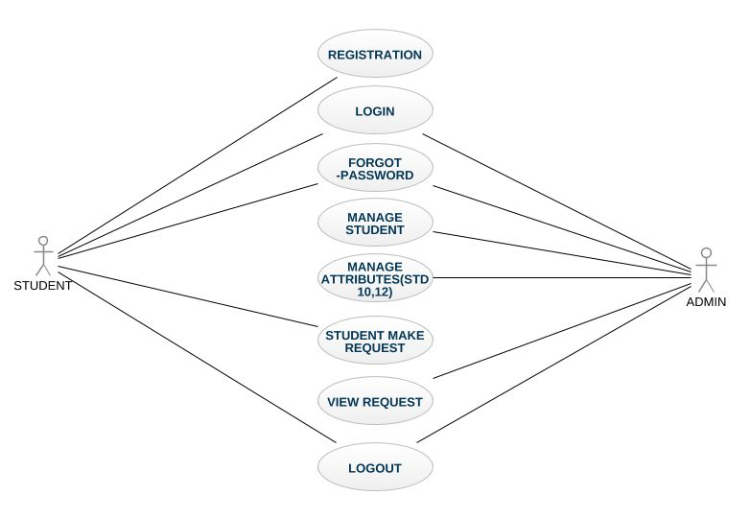
16
UseCase Diagram :-

Slide 17
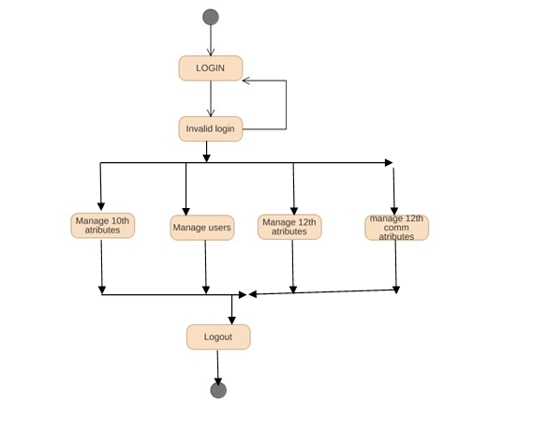
17
Activity Diagram :-
1. Admin

Slide 18
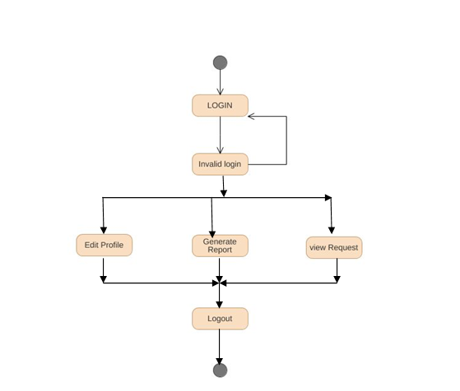
17
Activity Diagram :-
2. Student

Slide 19
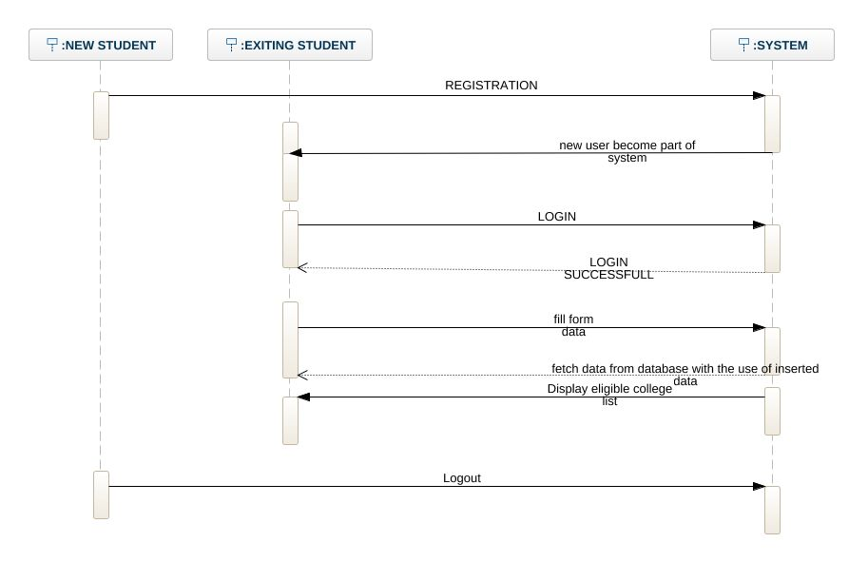
20
Sequence Diagram :-
1. Generate suggestions

Slide 20
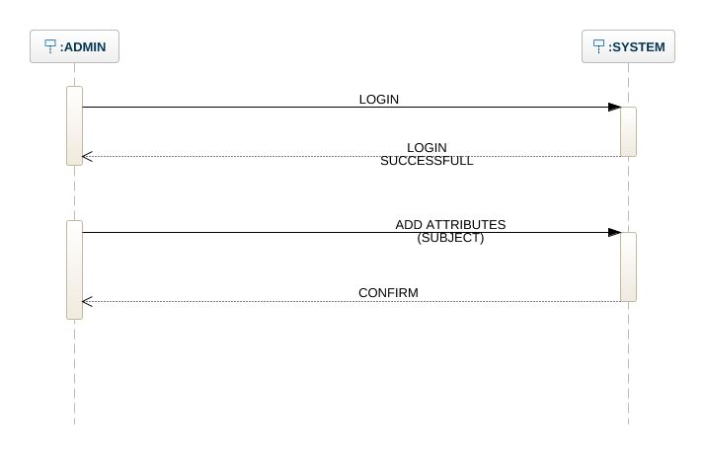
21
Sequence Diagram :-
2. Add attributes (by admin)

Slide 21
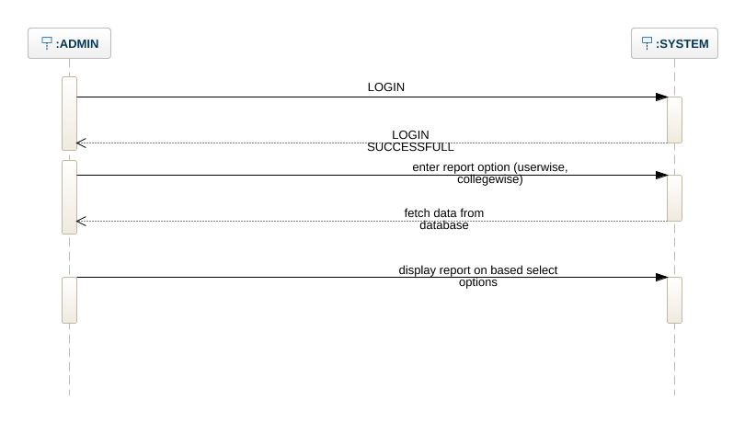
22
Sequence Diagram :-
3. Generate reports (by admin):

Slide 22
THANK YOU!:-)

